Slide 1


Ishanee Neb
19 June 2025

Slide 2

Outline
Executive Summary
Introduction
Methodology
Results
Conclusion
Appendix

Slide 3
Executive Summary
In this report, we predict whether the SpaceX Falcon 9 first stage will land successfully.
The main steps in this project include:
Data collection, wrangling, and formatting
Exploratory data analysis
Interactive data visualization
Machine learning prediction
In this report, it is also concluded that decision tree may be the best machine learning algorithm to predict if the Falcon 9 first stage will land successfully.

Slide 4
Introduction
Through this report, we can predict if the Falcon 9 first stage will land successfully. SpaceX advertises Falcon 9 rocket launches on its website with a cost of 62 million dollars; other providers cost upward of 165 million dollars each, much of the savings is because SpaceX can reuse the first stage. Therefore if we can determine if the first stage will land, we can determine the cost of a launch.
The main question that we are trying to answer is, for a given set of features about a Falcon 9 rocket launch which include its payload mass, orbit type, launch site, and so on, will the first stage of the rocket land successfully?

Slide 5

Section 1

Slide 6
Methodology
Executive Summary
Data collection methodology:
Data collection, wrangling, and formatting, using: a) SpaceX API b) Web scraping
Perform exploratory data analysis (EDA) using visualization and SQL
Exploratory data analysis (EDA), using: a) Pandas and NumPy b) SQL
Perform interactive visual analytics
Data visualization, using: a) Matplotlib and Seaborn b) Folium c) Dash
Perform predictive analysis using classification models
Machine learning prediction, using a) Logistic regression b) Support vector machine (SVM) c) Decision tree d) K-nearest neighbors (KNN)

Slide 7
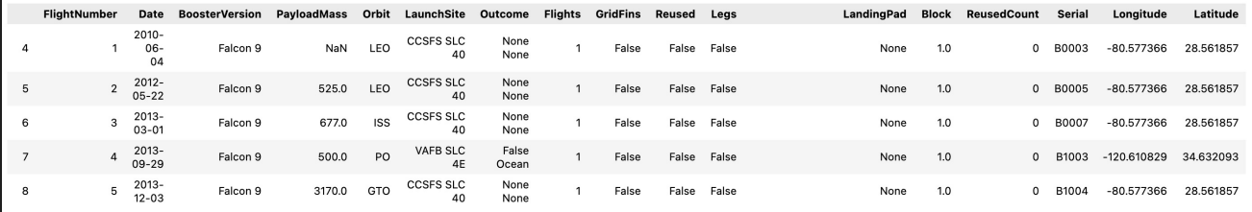

Data collection methodology
• SpaceX API
The API used is https://api.spacexdata.com/v4/rockets/.
The API provides data about many types of rocket launches done by SpaceX, the data is therefore filtered to include only Falcon 9 launches.
Every missing value in the data is replaced the mean the column that the missing value belongs to.
We end up with 90 rows or instances and 17 columns or features. The picture below shows the first few rows of the data:
Web scraping
The data is scraped from https://en.wikipedia.org/w/index.php?title=List_of_Falcon_9_and_Falcon_Heavy_launches& oldid=1027686922
The website contains only the data about Falcon 9 launches.
We end up with 121 rows or instances and 11 columns or features. The picture below shows the first few rows of the data:

Slide 8
Exploratory data analysis (EDA)
Pandas and NumPy
Functions from the Pandas and NumPy libraries are used to derive basic information about the data collected, which includes:
The number of launches on each launch site
The number of occurrences of each orbit
The number and occurrence of each mission outcome
SQL
The data is queried using SQL to answer several questions about the data such as:
The names of the unique launch sites in the space mission
The total payload mass carried by boosters launched by NASA (CRS)
The average payload mass carried by booster version F9 v1.1

Slide 9
Data Visualization
Matplotlib and Seaborn
Functions from the Matplotlib and Seaborn libraries are used to visualize the data through scatterplots, bar charts, and line charts.
The plots and charts are used to understand more about the relationships between several features, such as:
The relationship between flight number and launch site
The relationship between payload mass and launch site
The relationship between success rate and orbit type
Folium
Functions from the Folium libraries are used to visualize the data through interactive maps.
The Folium library is used to:
Mark all launch sites on a map
Mark the succeeded launches and failed launches for each site on the map
Mark the distances between a launch site to its proximities such as the nearest city, railway, or highway
Dash
Functions from Dash are used to generate an interactive site where we can toggle the input using a dropdown menu and a range slider.
Using a pie chart and a scatterplot, the interactive site shows:
The total success launches from each launch site
The correlation between payload mass and mission outcome (success or failure) for each launch site

Slide 10
Machine Learning Prediction
Functions from the Scikit-learn library are used to create our machine learning models.
The machine learning prediction phase include the following steps:
Standardizing the data
Splitting the data into training and test data
Creating machine learning models, which include:
Logistic regression
Support vector machine (SVM)
Decision tree
K nearest neighbors (KNN)
Fit the models on the training set
Find the best combination of hyperparameters for each model
Evaluate the models based on their accuracy scores and confusion matrix

Slide 11
Results
The results are split into 5 sections:
SQL (EDA with SQL)
Matplotlib and Seaborn (EDA with Visualization)
Folium
Dash
Predictive Analysis
In all of the graphs that follow, class 0 represents a failed launch outcome while class 1 represents a successful launch outcome

Slide 12

Section 2

Slide 13
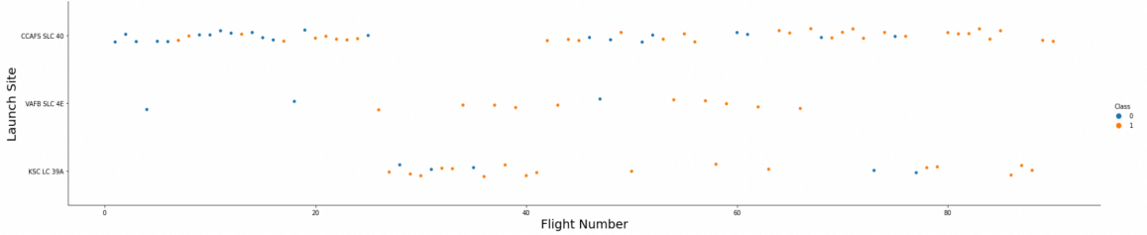
Flight Number vs. Launch Site
Explanation:
The earliest flights all failed while the latest flights all succeeded.
The CCAFS SLC 40 launch site has about a half of all launches.
VAFB SLC 4E and KSC LC 39A have higher success rates.
It can be assumed that each new launch has a higher rate of success.

Slide 14
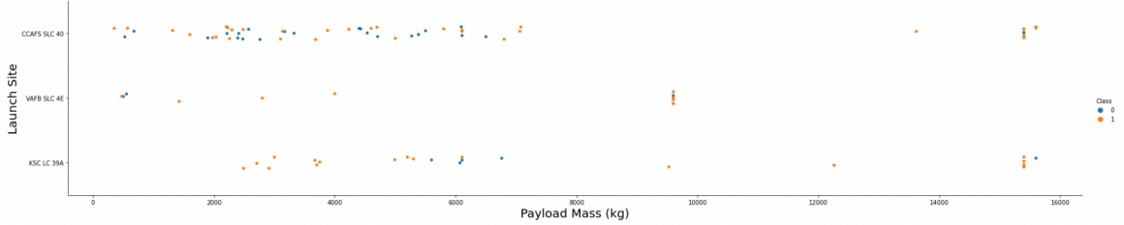
Payload vs. Launch Site
Explanation:
For every launch site the higher the payload mass, the higher the success rate.
Most of the launches with payload mass over 7000 kg were successful.
KSC LC 39A has a 100% success rate for payload mass under 5500 kg too.

Slide 15
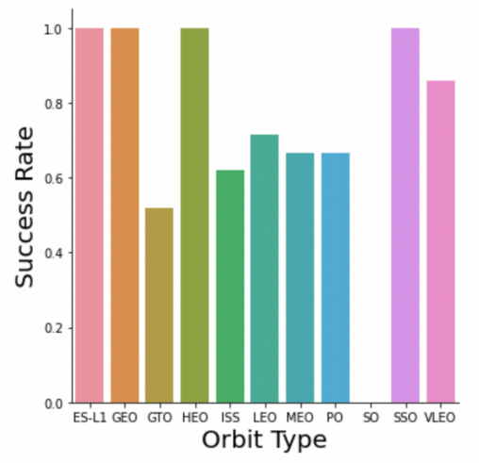
Success Rate vs. Orbit Type
Explanation:
Orbits with 100% success rate: - ES-L1, GEO, HEO, SSO
Orbits with 0% success rate: - SO
Orbits with success rate between 50% and 85%: - GTO, ISS, LEO, MEO, PO

Slide 16
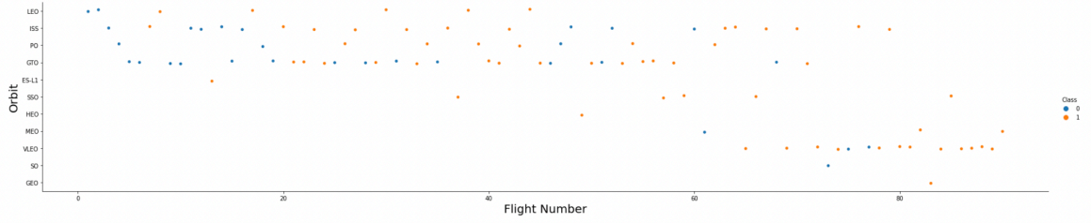
Flight Number vs. Orbit Type
Explanation:
In the LEO orbit the Success appears related to the number of flights; on the other hand, there seems to be no relationship between flight number when in GTO orbit.

Slide 17
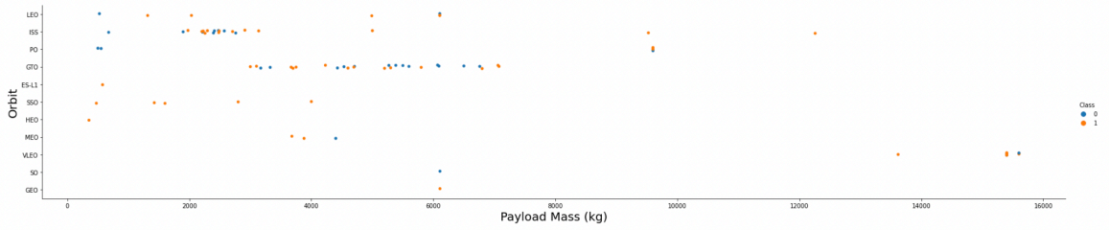
Payload vs. Orbit Type
Explanation:
Heavy payloads have a negative influence on GTO orbits and positive on GTO and Polar LEO (ISS) orbits.

Slide 18
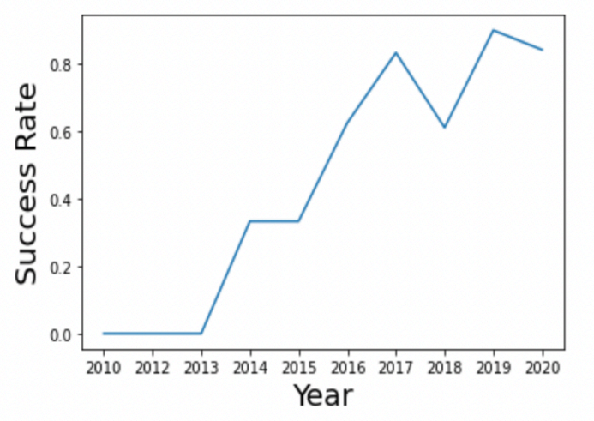
Launch Success Yearly Trend
Explanation:
The success rate since 2013 kept increasing till 2020.

Slide 19
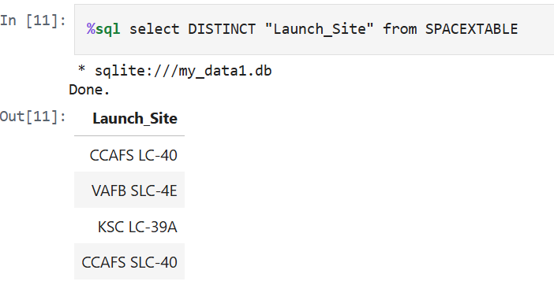
All Launch Site Names
Explanation:
Displaying the names of the unique launch sites in the space mission.

Slide 20
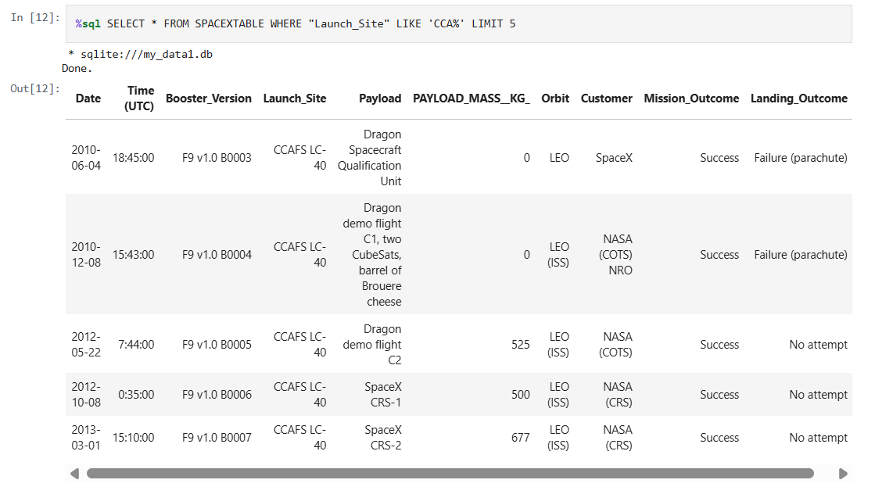
Launch Site Names Begin with 'CCA'
Explanation: Displaying 5 records where launch sites begin with the string 'CCA'.

Slide 21
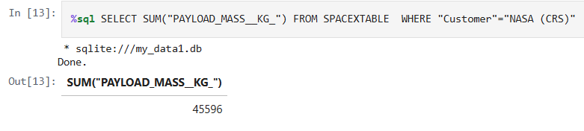
Total Payload Mass
Explanation:
Displaying the total payload mass carried by boosters launched by NASA (CRS).

Slide 22
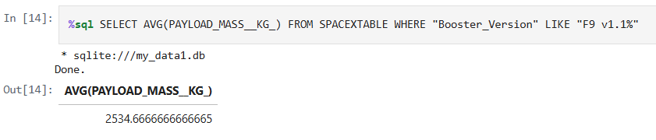
Average Payload Mass by F9 v1.1
Explanation:
Displaying average payload mass carried by booster version F9 v1.1

Slide 23
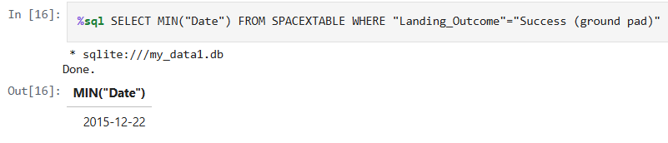
First Successful Ground Landing Date
Explanation:
Listing the date when the first successful landing outcome in ground pad was achieved.

Slide 24
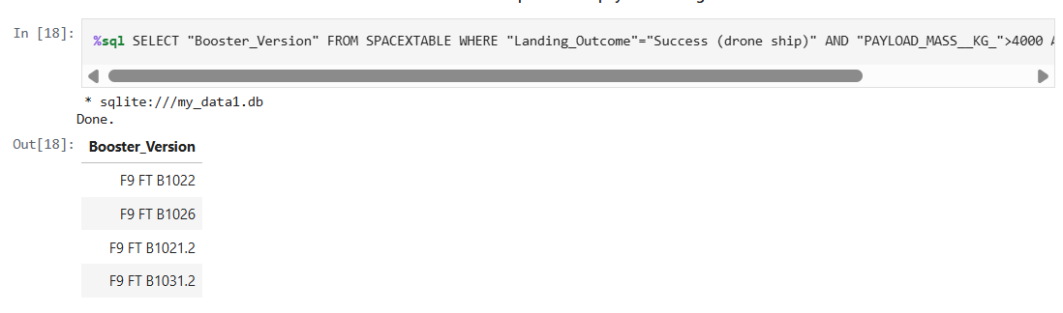
Successful Drone Ship Landing with Payload between 4000 and 6000
Explanation: Listing the names of the boosters which have success in drone ship and have payload mass greater than 4000 but less than 6000.

Slide 25
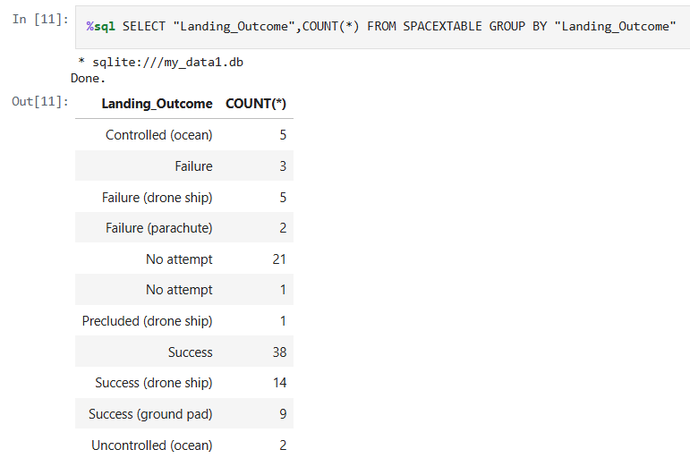
Total Number of Successful and Failure Mission Outcomes
Explanation:
Listing the total number of successful and failure mission outcomes.

Slide 26
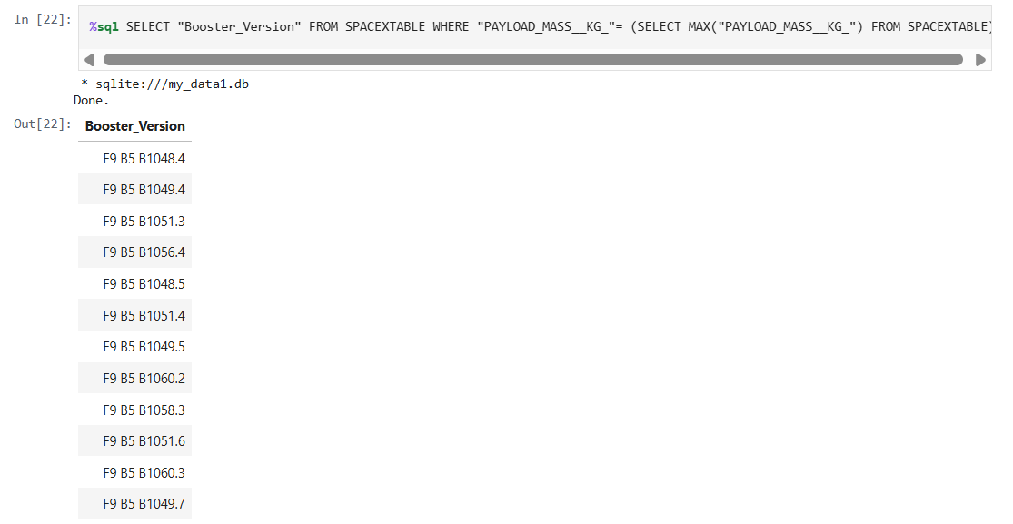
Boosters Carried Maximum Payload
Explanation:
Listing the names of the booster versions which have carried the maximum payload mass.

Slide 27
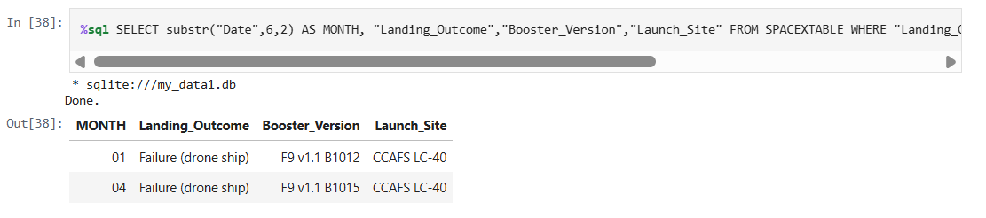
2015 Launch Records
Explanation:
Listing the failed landing outcomes in drone ship, their booster versions and launch site names for the months in year 2015

Slide 28
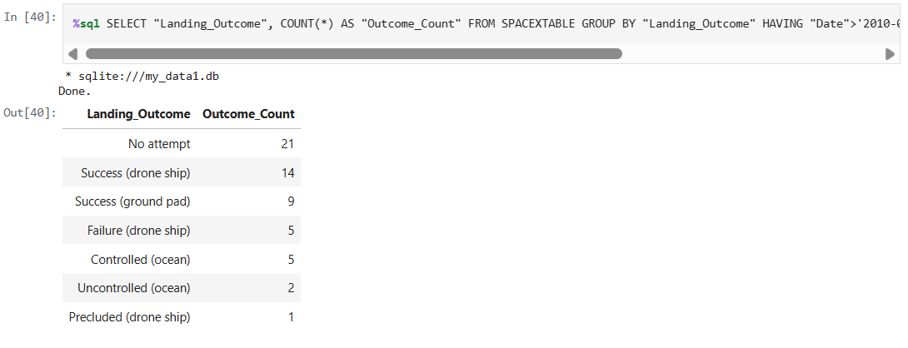
Rank Landing Outcomes Between 2010-06-04 and 2017-03-20
Explanation: Ranking the count of landing outcomes (such as Failure (drone ship) or Success (ground pad)) between the date 2010-06-04 and 2017-03-20 in descending order

Slide 29

Section 3

Slide 30
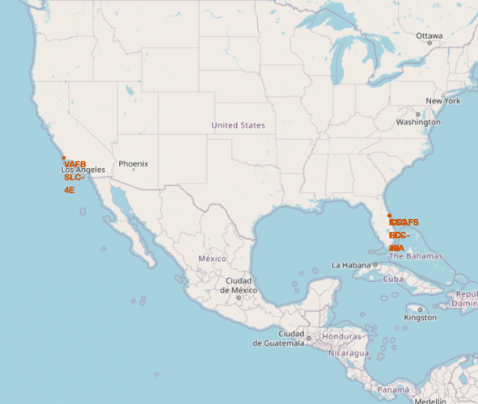
<Folium Map Screenshot 1>
Explanation:
Most of Launch sites are in proximity to the Equator line. The land is moving faster at the equator than any other place on the surface of the Earth. Anything on the surface of the Earth at the equator is already moving at 1670 km/hour. If a ship is launched from the equator it goes up into space, and it is also moving around the Earth at the same speed it was moving before launching. This is because of inertia. This speed will help the spacecraft keep up a good enough speed to stay in orbit.
All launch sites are in very close proximity to the coast, while launching rockets towards the ocean it minimises the risk of having any debris dropping or exploding near people.

Slide 31
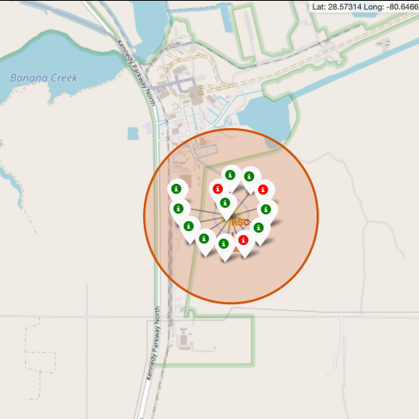
<Folium Map Screenshot 2>
Explanation:
From the colour-labeled markers we should be able to easily identify which launch sites have relatively high success rates.
- Green Marker = Successful Launch
- Red Marker = Failed Launch
Launch Site KSC LC-39A has a very high Success Rate.

Slide 32
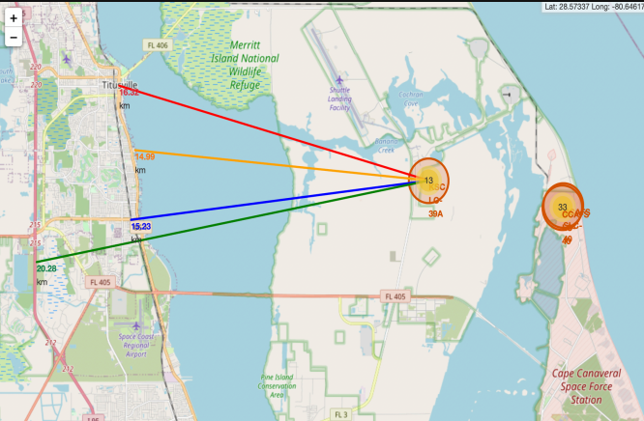
<Folium Map Screenshot 3>
Explanation:
From the visual analysis of the launch site KSC LC-39A we can clearly see that it is:
relative close to railway (15.23 km)
relative close to highway (20.28 km)
relative close to coastline (14.99 km)
Also the launch site KSC LC-39A is relative close to its closest city Titusville (16.32 km).
Failed rocket with its high speed can cover distances like 15-20 km in few seconds. It could be potentially dangerous to populated areas.

Slide 33

Section 4

Slide 34
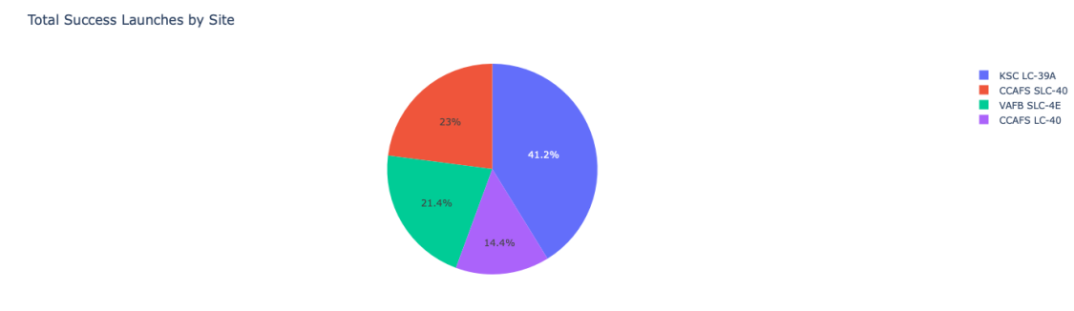
<Dashboard Screenshot 1>
Explanation:
The chart clearly shows that from all the sites, KSC LC-39A has the most successful launches.

Slide 35
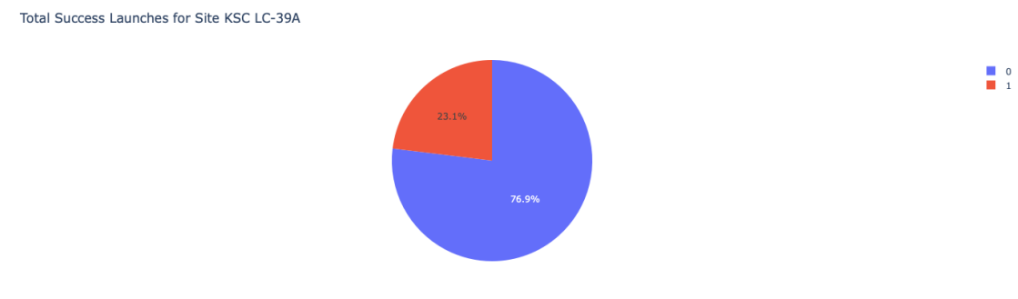
<Dashboard Screenshot 2>
Explanation:
KSC LC-39A has the highest launch success rate (76.9%) with 10 successful and only 3 failed landings.

Slide 36
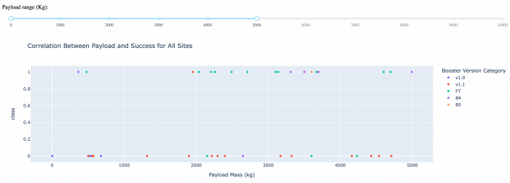
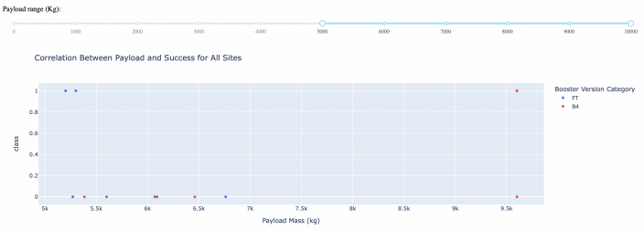
<Dashboard Screenshot 3>
Explanation:
The charts show that payloads between 2000 and 5500 kg have the highest success rate

Slide 37

Section 5

Slide 38
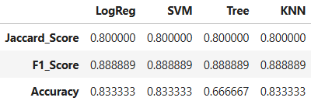
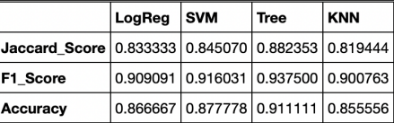
Classification Accuracy
Explanation:
Based on the scores of the Test Set, we can not confirm which method performs best.
Same Test Set scores may be due to the small test sample size (18 samples). Therefore, we tested all methods based on the whole Dataset.
The scores of the whole Dataset confirm that the best model is the Decision Tree Model. This model has not only higher scores, but also the highest accuracy.
Scores and Accuracy of the Test Set
Scores and Accuracy of the Entire Data Set

Slide 39
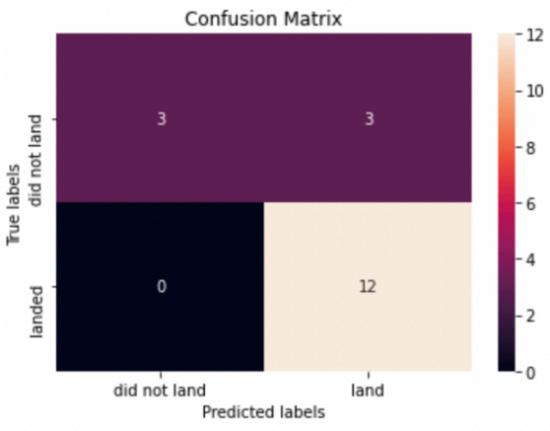
Confusion Matrix
Explanation:
Examining the confusion matrix, we see that logistic regression can distinguish between the different classes. We see that the major problem is false positives.

Slide 40
Conclusions
Decision Tree Model is the best algorithm for this dataset.
Launches with a low payload mass show better results than launches with a larger payload mass.
Most of launch sites are in proximity to the Equator line and all the sites are in very close proximity to the coast.
The success rate of launches increases over the years.
KSC LC-39A has the highest success rate of the launches from all the sites.
Orbits ES-L1, GEO, HEO and SSO have 100% success rate

Slide 41
Appendix
Special Thanks to: Instructors, Coursera and IBM

Slide 42


